Slide 1
Twitter Sentiment Analysis Using DNN Model with Tensorflow & Keras
ISOM5240
Daniel Tsai
Phillip Bonarigo

Slide 2
Executive Summary
Businesses need to be responsive to customers, and gather intelligence on their competition
We built a model to gather customer feedback on Twitter, a platform with 126 million daily active users who tweet 500 million times per day
Given the scale of information for large companies, we used a neural network to determine the sentiment of relevant tweets
Our model will get better using Twitter’s API to interact with and record new relevant data every day
Notes:
This includes competitive analysis, automation of some tasks, and other business intelligence.

Slide 3

Sentiment – knowing your customer is key to building a successful business
Notes:
Customers have different feelings at different times

Slide 4
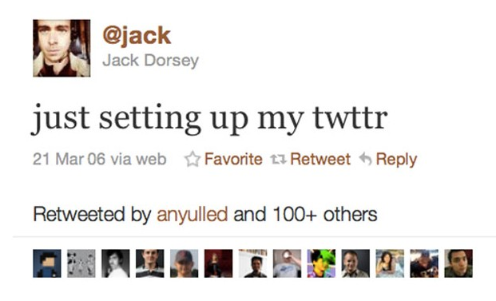
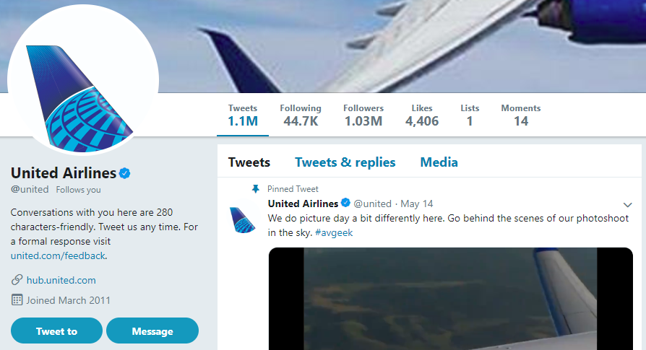
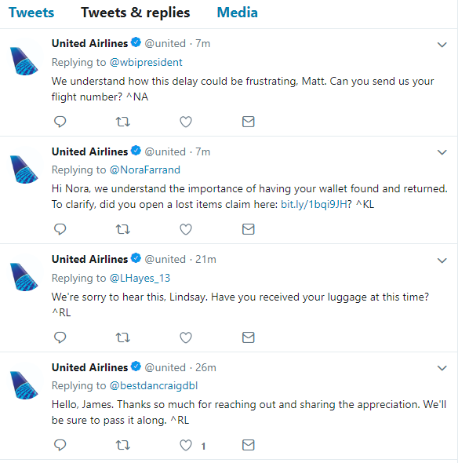
Twitter has become a main channel for communication – for both people and companies
Notes:
All large companies have a social media presence, with Twitter being one of the most popular for real-time communication with customers.
Twitter is a way to understand and respond to those feelings, but sometimes it isn’t clear what they mean. Sometimes it is negative (red), unclear (black), or positive (green).

Slide 5






The Flow
Data Preparation
Natural Language Processing(NLP): Tf_idf
Engineering
Database(sqlite) as input, a new data-friendly environment
Analytics
Accuracy/binary_crossentropy analysis
Overhaul
Dropout/L2 model to increase accuracy and reduce overfitting
Application
Twitter API scheduled to scan real-time testing data

Slide 6
We can use information from Twitter to gather actionable, real-time business intelligence
We want to mitigate customer issues (flag negative)
Celebrate customer successes (flag positive)
Deliver marketing intelligence and customer intelligence to the organization
Notes:
This includes competitive analysis, automation of some tasks, and other business intelligence.

Slide 7
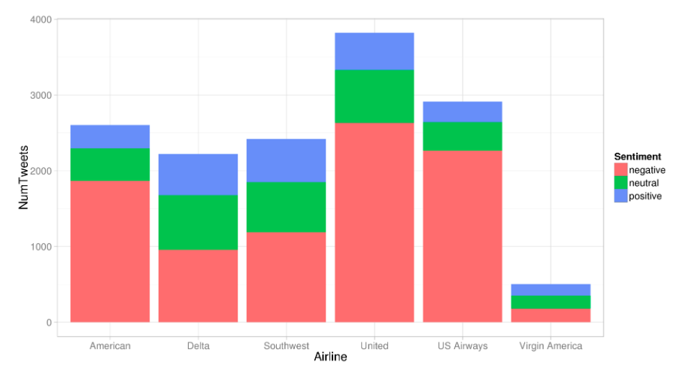
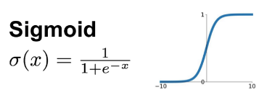
We can use information from Twitter to gather actionable, real-time business intelligence
n = 14,485
token = 16K
Activation function:
Notes:
Explanation about the training set, and how we extracted the information
term frequency-inverse document frequency
Put into SQLdatabase

Slide 8
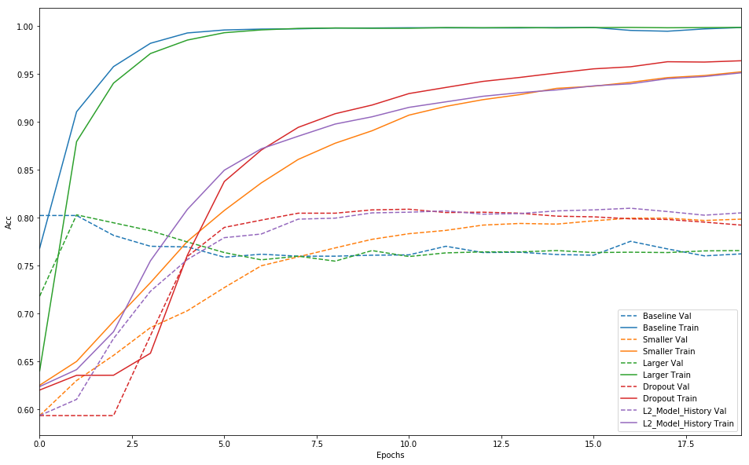
Acc(Negative)= 80%
Notes:
Negative/non-negative

Slide 9
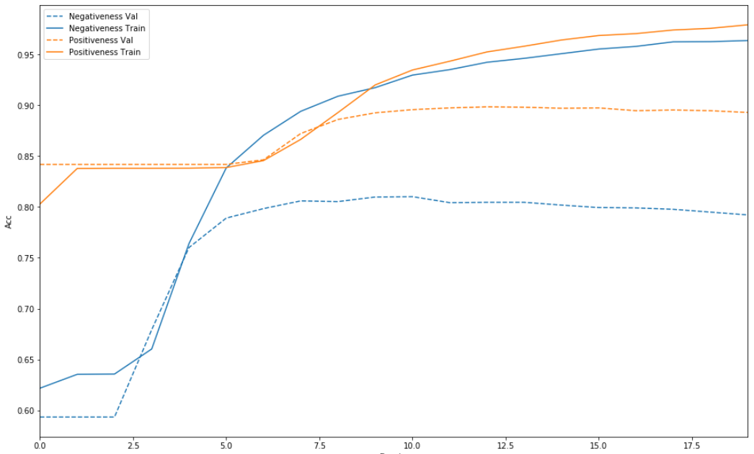
Acc(Positive)=89.3%
Notes:
Positive / non-positive

Slide 10
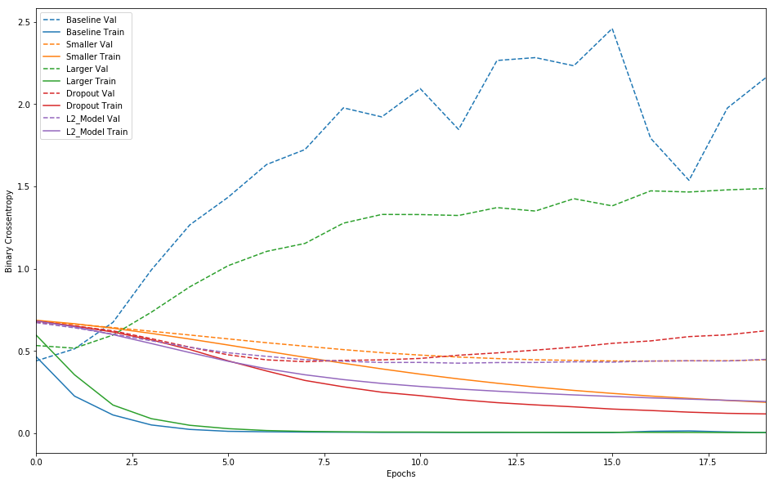
Overfitting decreases under Dropout model

Slide 11
Future Work
Create Multi-classification model, labeled as Negative, Neutral, and Positive
Try existing embedding models, e.g. Word2Vec, FastText, Elmo, BERT
Gather new data sources
Apply to international airlines
Develop customer segmentation / cohort analysis for analyzing sentiment changes over time
Notes:
This includes competitive analysis, automation of some tasks, and other business intelligence.

Slide 12
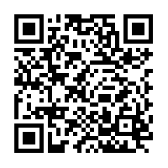
Try to beat it !
Tweet a message with #ISOM5240
Model identifies this Tweet, and determines whether it is negative, neutral, or positive
We respond accordingly
Real-time twitter channel:
https://twitter.com/search?q=%23ISOM5240&src=typd&lang=en
Notes:
Some real-time uses in-class, if possible

Slide 13
Thank you

Slide 14
Appendix
Files description
database.sqlite : the raw data of opinion of US airlines
ua.csv : : the sentiment prediction result of opinion of US airlines on twitter
usat_dpt.model : the model for prediction

